Slide 1


Computing Technology
Week 1: Scratch
2025-10-01
Course Leader:
Dr. Ed Harris
eharris@harper-adams.ac.uk
Dr. Megan Lewis
mjlewis@harper-adams.ac.uk

Slide 2
Today’s plan
Module Information
Account set ups
Introduction to Computing Technology
Basics of computing concepts
Scratch

Slide 3
Module Information
Session format
Assignments
Virtual Learning Environment
Module website

Slide 4
Session Format – Flipped Classroom
In own time before class
In class
Notes & slides
Code
Tutorials
Videos
Take note of any questions for class session
Review topics
Answer any questions or issues
Some practical coding run throughs
Opportunity to begin problem sets

Slide 5
Assignments
Problems Sets
Final Project
Due weekly
10 problems sets
Based on learning from materials and class sessions
Launch: 2023-10-15
Deadline: 2025-01-22
Individual or group
Develop an application using programming language of your choice to solve a real-world problem
All assignments submitted via GitHub Codespaces/Classroom

Slide 6
Not Reasonable
Using AI-based software to write your code

Slide 7
Reasonable
Using AI to ask questions

Slide 8
Module website tour

Slide 9



Account Setups

Slide 10
Account Setups
Demo: Create a repository for note keeping

Slide 11
Account Setups
Demo: Introduce yourself on module forum Find code help channel

Slide 12
Account Setups
Demo: Coming later in session

Slide 13
Account Setups

Slide 14
Visual Studio Github Codespace
The Sandbox

Slide 15
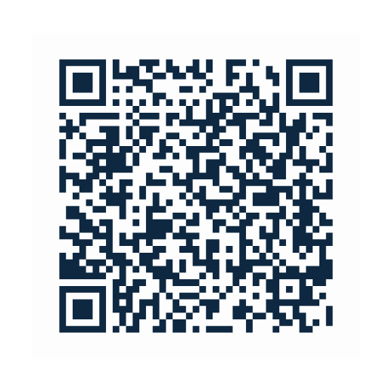

Break
Fill out form please

Slide 16
Computing technology
An introduction

Slide 17
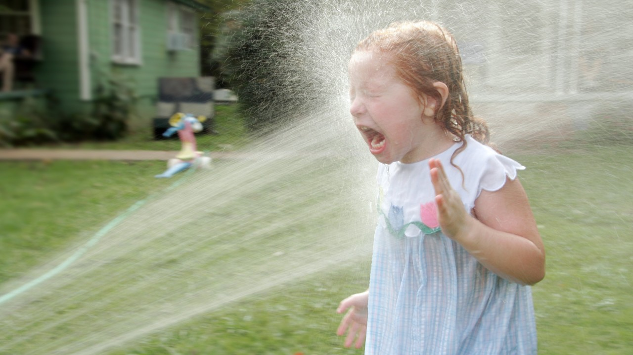
Drinking from the fire hose…

Slide 18

Rubber duck debugging
Notes:
Explain your code, line by line, to an inanimate object
Verbalising your codes logic to someone or something that knows nothing about it forces you to think through each step
Can help reveal errors, inconsistencies, or steps you might have missed otherwise
Solo activity
Works well with pseudocode – talk about later Engages a different part of brain
Fresh perspective

Slide 19

Getting code help - Discord
Code help channel
Minimum provision:
Code
Error Message
Context
Help and learn together

Slide 20
Basics of computing concepts

Slide 21
Basics of computing concepts
input
Notes:
Essentially, computer programming is about taking some input and creating some output - thus solving a problem. What happens in between the input and output, what we could call a black box, is the focus of this course.

Slide 22
Basics of computing concepts
input
output
Notes:
Essentially, computer programming is about taking some input and creating some output - thus solving a problem. What happens in between the input and output, what we could call a black box, is the focus of this course.

Slide 23
Basics of computing concepts
?
input
output
Notes:
Essentially, computer programming is about taking some input and creating some output - thus solving a problem. What happens in between the input and output, what we could call a black box, is the focus of this course.

Slide 24
Basics of computing concepts
Black box
input
output
Notes:
Essentially, computer programming is about taking some input and creating some output - thus solving a problem. What happens in between the input and output, what we could call a black box, is the focus of this course.

Slide 25
Basics of computing concepts
Black box
input
output
Problem solving!
Notes:
Essentially, computer programming is about taking some input and creating some output - thus solving a problem. What happens in between the input and output, what we could call a black box, is the focus of this course.

Slide 26

The language of computers
Unary
Binary
Binary digit → bit
ASCII
Unicode
RGB
Algorithms
Notes:
For example, we may need to take attendance for a class. We could use a system called unary (also called base-1) to count one finger at a time.
Computers today count using a system called binary. It’s from the term binary digit that we get a familiar term called bit. A bit is a zero or one: on or off.

Slide 27


The Language of Computers - Binary
0
1
Notes:
Computers only speak in terms of zeros and ones. Zeros represent off. Ones represent on. Computers are millions, and perhaps billions, of transistors that are being turned on and off.
If you imagine using a light bulb, a single bulb can only count from zero to one.

Slide 28
The Language of Computers - Binary
4
2
1
Notes:
However, if you were to have three light bulbs, there are more options open to you!
As a heuristic, we could imagine that the following values represent each possible place in our binary digit:
4 2 1
0

Slide 29
The Language of Computers - Binary
4
2
1
Notes:
1

Slide 30
The Language of Computers - Binary
4
2
1
Notes:
2

Slide 31
The Language of Computers - Binary
4
2
1
Notes:
3

Slide 32
The Language of Computers - Binary
4
2
1
Notes:
4

Slide 33
The Language of Computers - Binary
4
2
1
4
2
1
4
2
1
Notes:
5 6 7

Slide 34
The Language of Computers - Binary
4
2
1
2²
2¹
2⁰
Notes:
Computers use base-2 to count. This can be pictured as follows:
2^2 2^1 2^0 4 2 1
Therefore, you could say that it would require three bits (the four’s place, the two’s place, and the one’s place) to represent a number as high as seven.

Slide 35
The language of computers - Binary
128 64 32 16 8 4 2 1
8 bits
Notes:
Computers generally use eight bits (also known as a byte) to represent a number.
For example, 00000101 is the number 5 in binary.
11111111 represents the number 255. You can imagine zero as follows:

Slide 36
ASCII
Map specific letters to specific numbers
Notes:
Just as numbers are binary patterns of ones and zeros, letters are represented using ones and zeros, too!
Since there is an overlap between the ones and zeros that represent numbers and letters, the ASCII standard was created to map specific letters to specific numbers.
For example, the letter A was decided to map to the number 65. 01000001 represents the number 65 in binary. You can visualize this as follows:

Slide 37
ASCII
Map specific letters to specific numbers
e.g.,
A = 65 = 01000001
B = 66 = 01000010
C = 67 = 01000011
72
73
33
H
I
!
Notes:
If you received a text message, the binary under that message might represent the numbers 72, 73, and 33. Mapping these out to ASCII, your message would look as follows:
H I ! 72 73 33
Thank goodness for standards like ASCII that allow us to agree upon these values!
Here is an expanded map of ASCII values:

Slide 38

Unicode
Expand number of bits
Includes emojis & special characters
Notes:
As time has rolled on, there are more and more ways to communicate via text.
Since there were not enough digits in binary to represent all the various characters that could be represented by humans, the Unicode standard expanded the number of bits that can be transmitted and understood by computers. Unicode includes not only special characters, but emoji as well.
There are emoji that you probably use every day. The following may look familiar to you:
😀 😃 😄 😁 😆 😅 😂 🙂 🙃 😉 😊 😇 😍 😘 😗 😙 😚 😋 😛 😜 😝 🤑 🤓 😎 🤗 😏 😶 😐 😑 😒 🙄 😬 😕 ☹️ 😟 😮 😯 😲 😳 😦 😧 😨
While the pattern of zeros and ones is standardized within Unicode, each device manufacturer may display each emoji slightly differently than another manufacturer.
More and more features are being added to the Unicode standard to represent further characters and emoji.
If you wish, you can learn more about Unicode.
If you wish, you can learn more about emoji.

Slide 39
RGB
Notes:
Zeros and ones can also be used to represent colours
Red, green and blue are a combination of three numbers

Slide 40
RGB
72 | 73 | 33
Notes:
Taking our previously used 72, 73, and 33, which said HI! via text, would be interpreted by image readers as a light shade of yellow. The red value would be 72, the green value would be 73, and the blue would be 33.

Slide 41
RGB
72 | 73 | 33
Notes:
The three bytes required to represent various colors of red, blue, and green (or RGB) make up each pixel (or dot) of color in any digital image. Images are simply collections of RGB values.
Zeros and ones can be used to represent images, videos, and music!
Videos are sequences of many images that are stored together, just like a flipbook.
Music can be represented similarly using various combinations of bytes.

Slide 42



Notes:
Zeros and ones can be used to represent images, videos, and music!
Videos are sequences of many images that are stored together, just like a flipbook.
Music can be represented similarly using various combinations of bytes.

Slide 43
Algorithms

Slide 44

Algorithms
Step-by-step process

Slide 45
Algorithms
input
Black box
output
Step-by-step process
Notes:
Imagine the basic problem of trying to locate a single name in a phone book.
How might one go about this?

Slide 46



Algorithms
input
Black box
output
Step-by-step process
Notes:
Imagine the basic problem of trying to locate a single name in a phone book.
How might one go about this?

Slide 47
Algorithms
One page at a time
Two pages at a time
Split the book in half and repeat…
Notes:
Imagine the basic problem of trying to locate a single name in a phone book.
How might one go about this? One approach could be to simply read from page one to the next to the next until reaching the last page.
Another approach could be to search two pages at a time.
A final and perhaps better approach could be to go to the middle of the phone book and ask, “Is the name I am looking for to the left or to the right?” Then, repeat this process, cutting the problem in half and half and half.

Slide 48
Algorithms
One page at a time
Two pages at a time
Split the book in half and repeat…
Speed?
Notes:
Imagine the basic problem of trying to locate a single name in a phone book.
How might one go about this? One approach could be to simply read from page one to the next to the next until reaching the last page.
Another approach could be to search two pages at a time.
A final and perhaps better approach could be to go to the middle of the phone book and ask, “Is the name I am looking for to the left or to the right?” Then, repeat this process, cutting the problem in half and half and half.

Slide 49
Algorithms
Time to solve
Size of Problem

Slide 50
Algorithms
n
Time to solve
Size of Problem
Notes:
One approach could be to simply read from page one to the next to the next until reaching the last page.

Slide 51
Algorithms
n
n/2
Time to solve
Size of Problem
Notes:
Another approach could be to search two pages at a time.

Slide 52
Algorithms
n
n/2
Time to solve
log₂n
Size of Problem
Notes:
A final and perhaps better approach could be to go to the middle of the phone book and ask, “Is the name I am looking for to the left or to the right?” Then, repeat this process, cutting the problem in half and half and half.

Slide 53
Pseudocode
Notes:
Process of converting instructions into code is called pseudo code Important skill
Think through the problem
Help others understand your code after you’ve finished
Goes nicely with rubber duck debugging

Slide 54
Pseudocode
1 Pick up phone book
Notes:
Important skill
Think through the problem
Help others understand your code after you’ve finished
Goes nicely with rubber duck debugging

Slide 55
Pseudocode
1 Pick up phone book
2 Open to middle of phone book
Notes:
Important skill
Think through the problem
Help others understand your code after you’ve finished
Goes nicely with rubber duck debugging

Slide 56
Pseudocode
1 Pick up phone book
2 Open to middle of phone book
3 Look at page
Notes:
Important skill
Think through the problem
Help others understand your code after you’ve finished
Goes nicely with rubber duck debugging

Slide 57
Pseudocode
1 Pick up phone book
2 Open to middle of phone book
3 Look at page
4 If person is on page
5 Call person
Notes:
Important skill
Think through the problem
Help others understand your code after you’ve finished
Goes nicely with rubber duck debugging

Slide 58
Pseudocode
1 Pick up phone book
2 Open to middle of phone book
3 Look at page
4 If person is on page
5 Call person
6 Else if person is earlier in book
7 Open to middle of left half of book
8 Go back to line 3
Notes:
Important skill
Think through the problem
Help others understand your code after you’ve finished
Goes nicely with rubber duck debugging

Slide 59
Pseudocode
1 Pick up phone book
2 Open to middle of phone book
3 Look at page
4 If person is on page
5 Call person
6 Else if person is earlier in book
7 Open to middle of left half of book
8 Go back to line 3
9 Else if person is later in book
10 Open to middle of right half of book
11 Go back to line 3
Notes:
Important skill
Think through the problem
Help others understand your code after you’ve finished
Goes nicely with rubber duck debugging

Slide 60
Pseudocode
1 Pick up phone book
2 Open to middle of phone book
3 Look at page
4 If person is on page
5 Call person
6 Else if person is earlier in book
7 Open to middle of left half of book
8 Go back to line 3
9 Else if person is later in book
10 Open to middle of right half of book
11 Go back to line 3
12 Else
13 Quit
Notes:
Pseudocoding is such an important skill for at least two reasons. First, when you pseudocode before you create formal code, it allows you to think through the logic of your problem in advance. Second, when you pseudocode, you can later provide this information to others that are seeking to understand your coding decisions and how your code works.

Slide 61
Pseudocode
1 Pick up phone book
2 Open to middle of phone book
3 Look at page
4 If person is on page
5 Call person
6 Else if person is earlier in book
7 Open to middle of left half of book
8 Go back to line 3
9 Else if person is later in book
10 Open to middle of right half of book
11 Go back to line 3
12 Else
13 Quit
Notes:
Notice that the language within our pseudocode has some unique features.
First, some of these lines begin with verbs like pick up, open, look at. Later, we will call these functions.

Slide 62
Pseudocode
1 Pick up phone book
2 Open to middle of phone book
3 Look at page
4 If person is on page
5 Call person
6 Else if person is earlier in book
7 Open to middle of left half of book
8 Go back to line 3
9 Else if person is later in book
10 Open to middle of right half of book
11 Go back to line 3
12 Else
13 Quit
Notes:
Second, notice that some lines include statements like if or else if. These are called conditionals.

Slide 63
Pseudocode
1 Pick up phone book
2 Open to middle of phone book
3 Look at page
4 If person is on page
5 Call person
6 Else if person is earlier in book
7 Open to middle of left half of book
8 Go back to line 3
9 Else if person is later in book
10 Open to middle of right half of book
11 Go back to line 3
12 Else
13 Quit
Notes:
Third, notice how there are expressions that can be stated as true or false, such as “person is earlier in the book.” We call these boolean expressions.

Slide 64
Pseudocode
1 Pick up phone book
2 Open to middle of phone book
3 Look at page
4 If person is on page
5 Call person
6 Else if person is earlier in book
7 Open to middle of left half of book
8 Go back to line 3
9 Else if person is later in book
10 Open to middle of right half of book
11 Go back to line 3
12 Else
13 Quit
Notes:
Finally, notice how there are statements like “go back to line 3.” We call these loops.
These building blocks are the fundamentals of programming.

Slide 65
Artificial Intelligence
If student says hello
Say hello
Else if student says goodbye
Say goodbye
Else if student asks how you are
Say well
Else if student asks why 111 in binary is 7 in decimal ...
Notes:
Consider how we can utilize the building blocks above to start creating our own artificial intelligence. Look at the following pseudocode:
Notice how just to program a handful of interactions, many lines of code would be required. How many lines of code would be required for thousands or tens of thousands of possible interactions?
Rather than programming conversational AI like the above, AI programmers train large language models (LLMs) on large datasets.
LLMs look at patterns in large blocks of language. Such language models attempt to create a best guess of what words come after one another or alongside one another.
You may use AI-based software to ask questions, but not presenting its answers as your own.
You may not use AI-based software (including ChatGPT, GitHub Copilot, the new Bing, et al.) to suggests answers for your work or lines of code.

Slide 66
Break
Fill out form please

Slide 67
This week

Slide 68
Introducing scratch
Visual programming language
Uses same essential coding building blocks as other languages
Functions
Conditionals
Boolean expressions
Loops
Etc…

Slide 69
Scratch demos
Meet the scratch IDE
Demos
Hello World
Hello, You
Meow & Abstraction
Conditionals
Oscartime
Ivy’s Hardest Game

Slide 70
Week 1 problem set
Your project must include:
At least 2 sprites
At least three scripts
One conditional
One loop
At least one variable
At least one custom block
Submit using GitHub Codespaces
Live demo example

Slide 71
Reminders
Submit problem set by 23:00 (11pm) on the Tuesday before next Computing Technology class
If you get stuck?
Check through tips on the website
Drop a message on Discord

Slide 72

Time to code…

